Slide 1
“GREAT GAME”
AND RIVALRY FOR CENTRAL ASIA
Cholpon CHOTAEVA
Anthropology, AUCA

Slide 2
Contents
Great Game
Reasons of Russian Empire
Reasons of Kyrgyzs
Conquest of Central Asia
Conquest of Kyrgyzs
Colonial rule
Rebellions
Consequences

Slide 3
Great Game
Great Game - the rivalry between the British Empire and the Russian Empire for supremacy in Central Asia (1813-1907)
The Great Game term is attributed to Arthur Conolly, an officer of British army , and the writer Kipling who popularized it in his novel in 1900

Slide 4
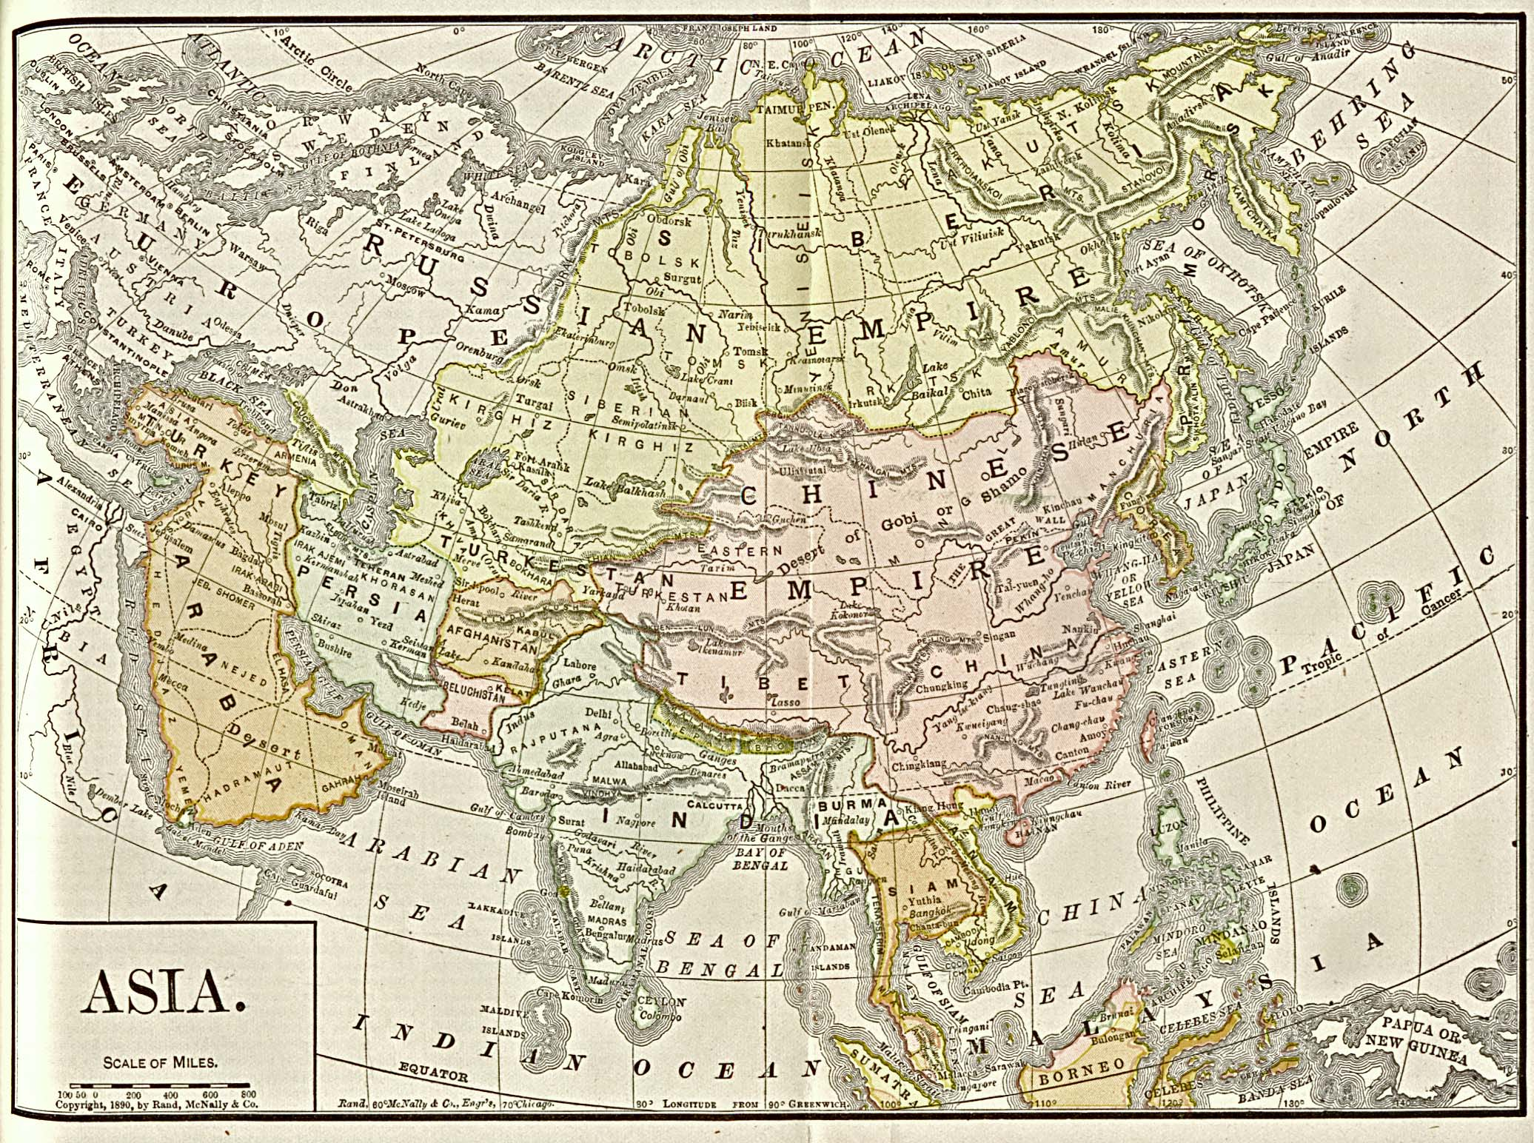

Slide 5
Reasons of Russian Empire
Political :
to get a new territory and land
Economic:
to receive new resources
a source of cheap labor
a market for Russian goods

Slide 6
Reasons of Kyrgyzs
Internal:
intertribal conflicts of Kyrgyzs
the lack of Kyrgyz statehood
External:
Kyrgyz-Kazakh conflicts
Chinese attempts to invade Kyrgyz territory
Koqand rule

Slide 7
Kyrgyz Embassies
1785 - first embassy by Atake baatyr, sarybagysh tribe, to Catherine II in Sankt Petersburg (Abdyrakhman Kuchakov and Shergazy)
1813 - an embassy by bugu tribe to Semipalatinsk (Kachibek and Jakypbek)
1825 - a kurultai of bugu tribe, where it was decided to join Russia

Slide 8
Conquest of Central Asia
Two stages:
1730-1848 - the conquest of Kazakhstan: Lesser Horde or Juz (a hundred) in the west, the Middle Juz in the central part and the Greater Juz in the southeast
1864-1884 - the conquest of Uzbekistan, Kyrgyzstan, Tajikistan and Turkmenistan: Bukhara Khanate (1868), Khiva Khanate (1873) and Khoqand Khanate and its abolition (1876)

Slide 9
Conquest of Kyrgyzs
Two stages:
1855-1868 - the incorporation of the northern Kyrgyz tribes
1855 - bugu tribe
1862-5 - Chui (sarybagysh, solto) and Talas (saruu, kushchu) Kyrgyzs
1864-5 - Naryn (cherik, sayak) Kyrgyzs
1865-1876 - the conquest of the south
1865 - Tashkent was occupied
1875-1876 - Alai military campaign led by Skobelev

Slide 10
Colonial rule: administrative-territorial system
1867 - Turkestan Governorate-General was established in Central Asia (Tashkent): General Konstantin von Kaufman (1867-1882)
Oblasts: Syrdarya (center Tashkent),
Semirechye (center Vernyi)
Fergana (center Skobelev)
Samarkand (center Samarkand)
Zakaspie (Transcaspia, center Ashgabad)
Uezds
Volosts
Ayils
Two protectorates: Bukhara and Khiva

Slide 11
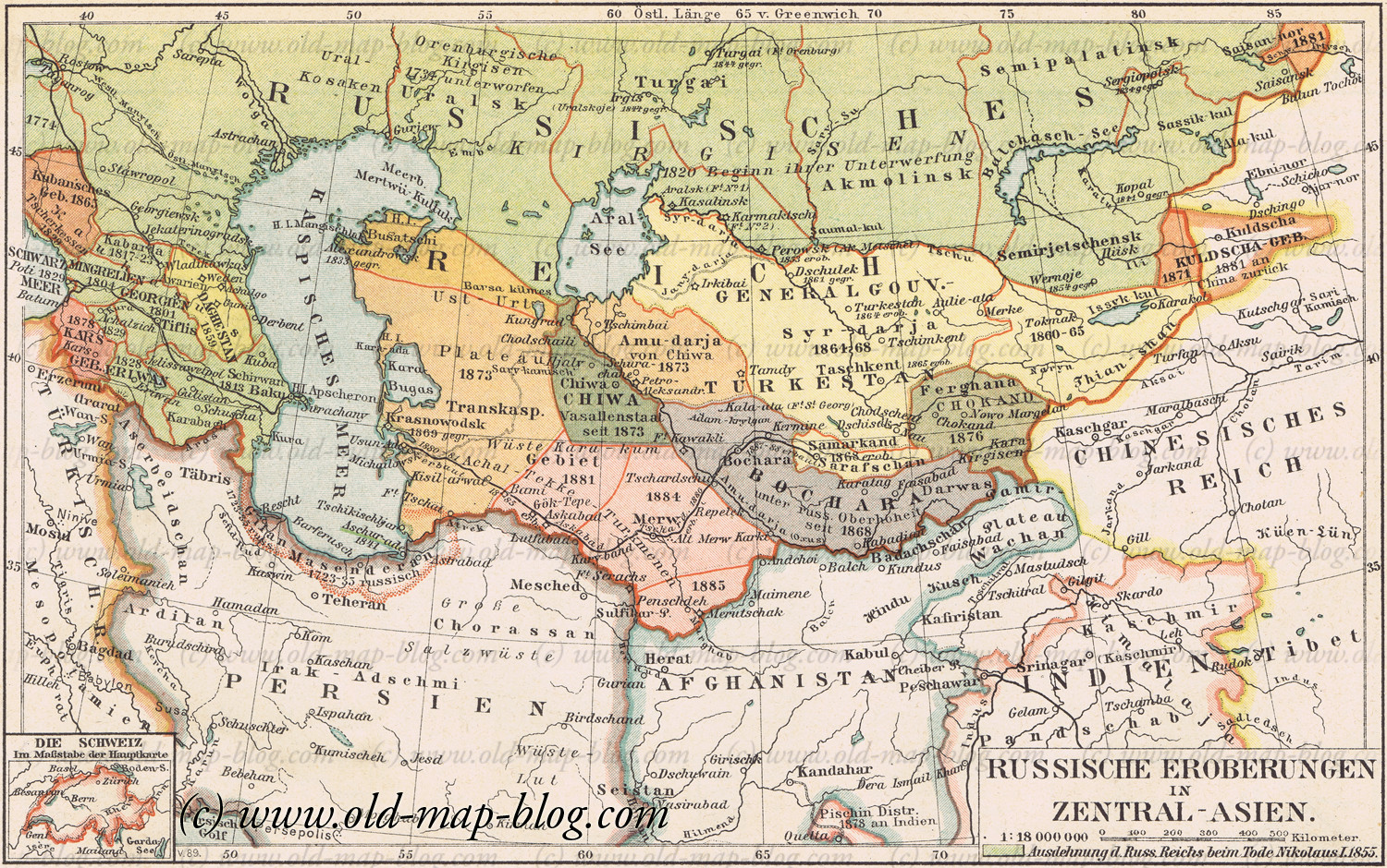

Slide 12
Colonial rule: economy
Central Asia was a supplier of raw materials (cotton)
Colonization of Central Asia by agricultural settlers, Russians and Ukrainians (land seizure)
Land was announced state
Taxes :
kharaj - tax on grain lands paid by grain
tanap - tax on garden and vegetable products paid by money
kibitka tax – tax on yurt
cattle tax – tax on cattle

Slide 13
Colonial rule: culture
Islam, traditional institutions and practices based on shariat and adat, were preserved
Russo-native schools were opened
New-method Muslim schools were established by Muslim reformers inspired by Jadidism (a cultural and educational reformist movement)
Kyrgyz traditional culture was revived
Manas epic and small epics
Akyn songs
First written hisories

Slide 14
Rebellions
1898 Andijan Rebellion - 200 lightly armed men attacked Russian forces at Andijan
Leaders: Madali Dukchi, Ziyadin Maksym
Territory: Fergana Valley
Composition: Kyrgyzs, Uzbeks, Tajiks
Reasons: Colonial policy
Result: 18 executed and 356 exile to Siberia
Character: popular, anti-colonial, anti-Russian, national-liberation

Slide 15
Rebellions
1916 Rebellion in Kyrgyzstan
Territory: south (Osh, Uzgen)
north (Kemin, Tokmok, Pishpek, etc)
Leaders: Manap Mokush Shabdan (Kemin)
Reasons: Colonial policy (land issue, taxes), WWI
Composition: Kyrgyzs, Uzbeks, Tajiks, Kazakhs, Uighurs
Pretext: Degree on the mobilization of men aged 19-43 for military-defensive works
Character: popular, anti-colonial, anti-Russian, national-liberation
Result: suppression, genocide of Kyrgyzs (70% were killed in the north), outcome to China

Slide 16
Consequences (positive)
Political:
intertribal conflicts of Kyrgyzs was put an end
the threat of colonization by China, Khoqand, Britain was eliminated
slavery was abolished
the new administrative-territorial system was introduced
Economic:
the new capitalist economic and market relations
the settled life style to and agricultural economy
Cultural:
the beginning of research and study of Central Asia and Kyrgyzstan
first records of folklore, history and language

Slide 17
Consequences (negative)
Political:
Central Asia was a colony of the Russian Empire
no state
many victims
Economic:
the shortage of land for Central Asians
the region of monoculture (cotton)
Cultural:
gradual elimination of religious institutions

Slide 18
Reading
Schuyler, Eugene. Turkistan Notes of a Journey in Russian Turkistan, Khokand, Bukhara and Kuldja, Vol. 2 (New York, 1876), pp 137-142

